Slide 1
Satellite Network IETF 115 Hackathon
Huawei & Nanjing University
November 5-11, 2022

Slide 2
Hackathon Plan
Hypatia Platform:
Generation of satellite network topology and routing.
Traffic Generation and Simulation of Traffic Transmission over Satellite Networks.
Visualization of Constellation, Display the dynamic topology of satellite network.
UltraStar Platform:
Configuration of satellite network parameters.
Topology management of Large-scale satellite network.

Slide 3
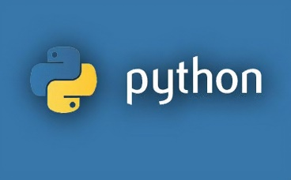


Hackathon Development
Build Enviroment:
OS
Windows10
Hyper-v
10.0
Virtual Machine OS
Ubuntu 20.04
Python
3.8
G++/Gcc
9.4

Slide 4
Hypatia Introduction
Hypatia is a low earth orbit (LEO) satellite network simulation framework.
Capabilities：
Control of ISL/GSL connection setup
NS3 packet-level simulation
Visualization of link utilization
Generation of time slice “fstate”
Available Research：
Orbital dynamics
Evaluation of constellation performance
Simulation of RTT delay and path switching, and TCP performance
Research on Load Balancing
Research on Routing Algorithms, such as “virtual topology”
Notes:
Reusing locators of SRv6

Slide 5
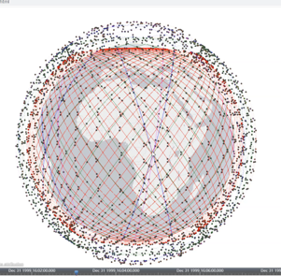
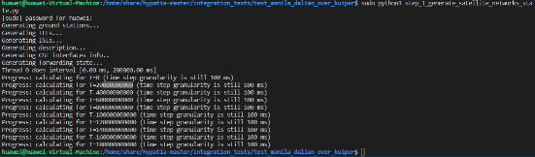
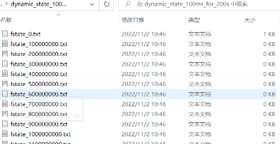
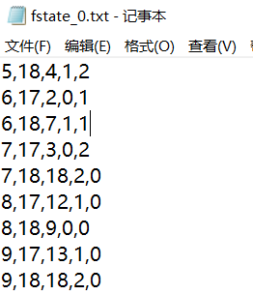
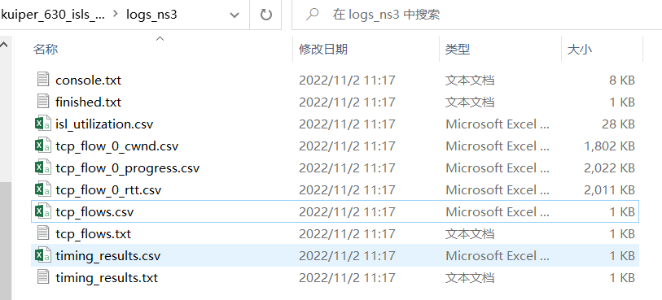
Demo & Result
Step1: Generation of topology and Routing Table.
Constellation: Kuiper;
Ground Station: Manila, Dalian
Step4: Visualization of Constellation
Step2: Generation of TCP traffic configuration
Step3: Simulation of Traffic Transmission over Satellite Networks.

Slide 6
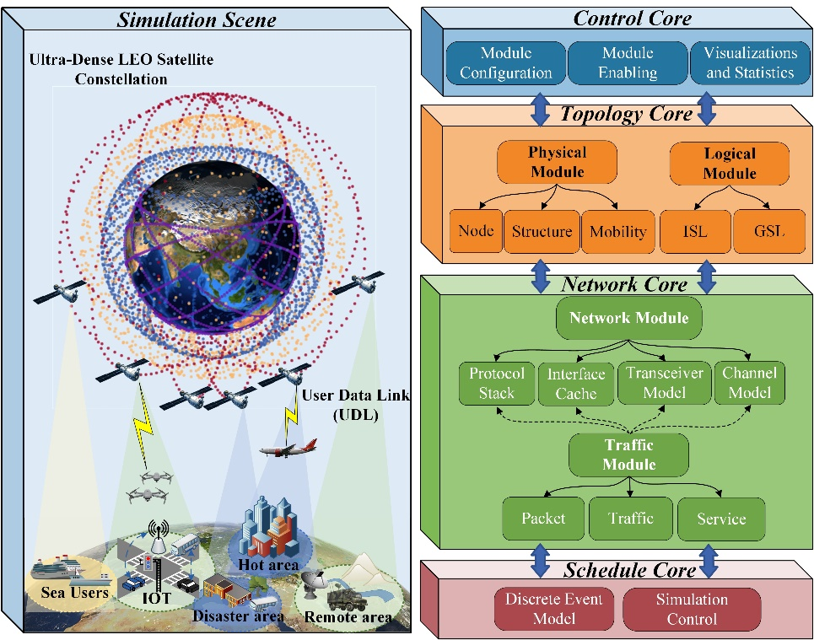
UltraStar: A Lightweight Simulator of Ultra-Dense LEO Satellite Constellation Networking
UltraStar is a discrete event based simulator, designed as a platform to test protocols and management methods in ultra-dense LEO constellations.
Topology Management
- Dynamic topology for any constellation configuration.
- Maintenance and update of satellite link status.
Networking Simulation
- Protocol-level network simulation.
- Tests new protocols and management methods.
Visualization and Statistics
- Topology visualization, simulation information statistics.

Slide 7
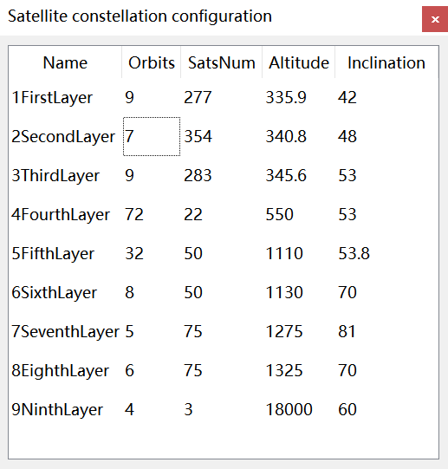
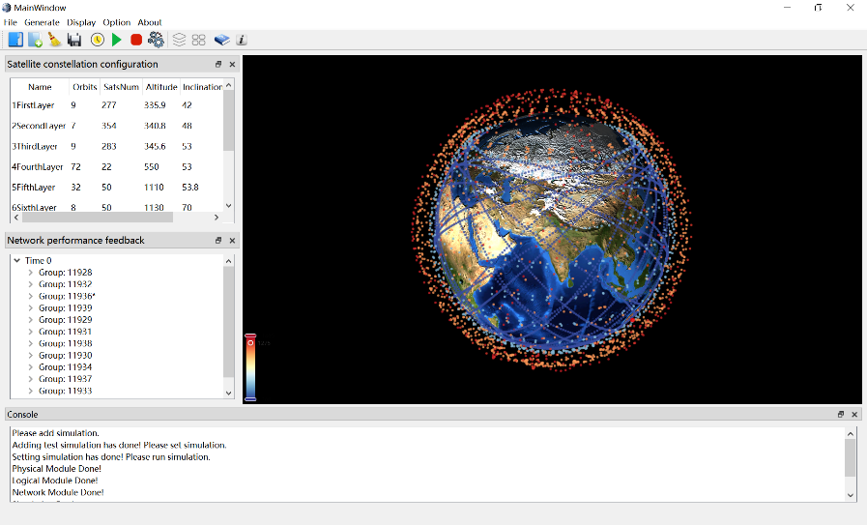
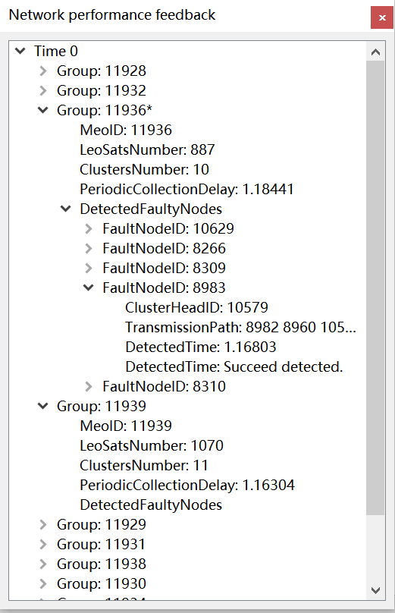
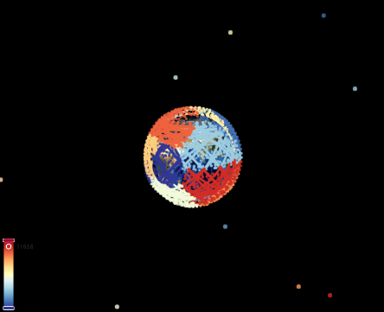
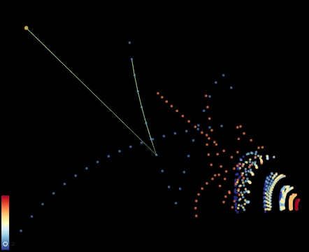
Demo & Result
Two-layer topology management architecture
Each MEO centrally manages LEO satellites in its line of sight, which form one group.
Each group is divided into clusters according to the adjacency principle.
Each cluster head (CH) manages satellites in its cluster and reports the intra-cluster information to the manager MEO.
Real-time satellite fault information management
Each LEO satellite periodically collects the status information of neighboring LEO satellites, which is further reported to the CH.
Once receiving the intra-cluster status information, CH reports it to the manager MEO, the MEO then sends fault responses to the confirmed faulty satellites.

Slide 8
What we learned
Simulation platform is very helpful to the research of satellite network, it provides a low cost method to study satellite network.
In the future:
Adapting more routing protocols to the satellite network.
Like discussing in TVR group, How does the satellite use the planed changes to the topology for routing?
Cooperate with partners who interest in satellite network, join us to improve it together!
Notes:
http://ceni.org.cn/

Slide 9
Thank you :)
Team members(Huawei):
Zhenbin Li (lizhenbin@huawei.com)
Qiangzhou Gao (gaoqiangzhou@huawei.com)
Li Zhang (zhangli344@Huawei.com)
Open Communities: https://github.com/Satellite-Routing
Team members(NJU):
Haibo Zhou (haibozhou@nju.edu.cn)
Xiaoyu Liu (xyliu0119@163.com）
Ting Ma (majiawan27@163.com)
Zhixuan Tang (zhixuantang@smail.nju.edu.cn)
Xiaohan Qin (xhderemail@smail.nju.edu.cn)
IETF 110 Hackathon: Application-aware G-SRv6 networking

